Slide 1
NAME:CYRILSIGMOND.A
REGNO:au8138212050008
DEPARTMENT:INFORMATION TECHNOLOGY
COLLEGE NAME:SARANATHAN COLLEGE OF ENGINEERING
N.M ID:cyrilsigmond@gmail.com
Final Project
3/21/2024 Annual Review

Slide 2
PROJECT TITLE
Addressing Ambiguity and Uncertainty in Image-to-Image
Translation using Generative Adversarial Networks (GANs)
3/21/2024 Annual Review

Slide 3


AGENDA
1.PROBLEM STATEMENT
2.PROJECT OVERVIEW
3.WHO ARE THE END USERS?
4.YOUR VALUE AND ITS VALUE PROPOSITION
5.THE WOW IN THE SOLUTION
6.MODELLING
7.RESULTS
3/21/2024 Annual Review

Slide 4

PROBLEM STATEMENT
The realm of image-to-image translation through Generative Adversarial Networks (GANs) presents a promising avenue for various applications such as style transfer, image colorization, and domain adaptation. However, the efficacy of GANs in such tasks is often hindered by inherent challenges, including ambiguity and uncertainty in the translation process. Ambiguity arises due to the multiple plausible interpretations of input-output mappings, while uncertainty stems from the lack of ground truth supervision and the presence of noisy or incomplete data.
3/21/2024 Annual Review

Slide 5

PROJECT OVERVIEW
Objectives:
1.Review and analyze state-of-the-art techniques in image-to-image translation using GANs, including CycleGAN .
2.Identify key challenges and limitations in existing approaches, such as mode collapse, lack of diversity, and domain shift problems.
3.Develop novel GAN architectures and training strategies to address these challenges and enhance the quality and diversity of image translations.
4.Investigate methods for incorporating additional constraints, such as semantic labels or textual descriptions, to guide the translation process and improve semantic consistency.
Methodology:
1.Problem Identification: Identify and analyze the primary challenges faced by current GAN-based image translation methods, including mode collapse, and domain misalignment.
2.Model Development: Design and implement novel GAN architectures, loss functions, and training methodologies tailored to address the identified challenges and improve translation quality and diversity.
3.Experimentation: Conduct empirical experiments using benchmark datasets and real-world image pairs to evaluate the performance of the proposed methods in various scenarios and domains.
4.Evaluation: Quantitatively assess the generated translations using metrics such as perceptual similarity, diversity, and semantic consistency, as well as qualitative evaluations by human annotators.
3/21/2024 Annual Review

Slide 6

WHO ARE THE END USERS?
1.Computer Vision Researchers: Driving advancements in algorithms for image manipulation, enhancement, and transformation.
2.Artists and Designers: Utilizing techniques for creative image manipulation, artistic effects, and style transfer.
3.Medical Imaging Professionals: Leveraging image processing techniques for medical image generation, augmentation, and quality enhancement.
4.Automotive and Autonomous Systems: Utilizing image-to-image translation for generating synthetic training data, simulating diverse driving scenarios, and enhancing the robustness of autonomous systems.
3/21/2024 Annual Review

Slide 7

YOUR SOLUTION AND ITS VALUE PROPOSITION
Adversarial Training: CycleGAN employs a pair of generator networks and a pair of discriminator networks that are trained adversarially. The generators aim to translate images from one domain to another, while the discriminators try to distinguish between real and fake images in each domain.
Value Proposition:
No Paired Data Required:
Unlike traditional image translation methods that require paired training data (e.g., before-and-after images), CycleGAN can learn to translate images between domains without such pairs. This makes it particularly useful in scenarios where obtaining paired data is challenging or expensive.
Preservation of Semantic Content:
CycleGAN incorporates cycle consistency loss, which ensures that the translated images maintain the semantic content of the original images. This results in more accurate and visually appealing translations compared to methods that focus solely on pixel-level transformations.
Flexibility and Adaptability:
CycleGAN is versatile and can be applied to various image translation tasks across different domains, such as style transfer, season transfer, and domain adaptation. Its flexibility makes it applicable in a wide range of applications, from art generation to medical image analysis..
3/21/2024 Annual Review

Slide 8

THE WOW IN YOUR SOLUTION
WE HAVE IMPLEMENTED:
1.Comparison with Baselines: We can compare pix2pix with other image translation methods or baseline models. The pix2pix outperforms traditional techniques in terms of image quality, fidelity, and consistency.
2.Multi-Domain Translation:our same model can be trained to perform tasks such as turning sketches into realistic images, converting maps to satellite images, or changing day scenes to night scenes.
3.Interactive Interface: We have Developed an interactive interface where users can upload their own images and see them translated in real-time using the pix2pix model. This allows the audience to directly engage with the technology and witness its capabilities firsthand.
3/21/2024 Annual Review
‹#›

Slide 9
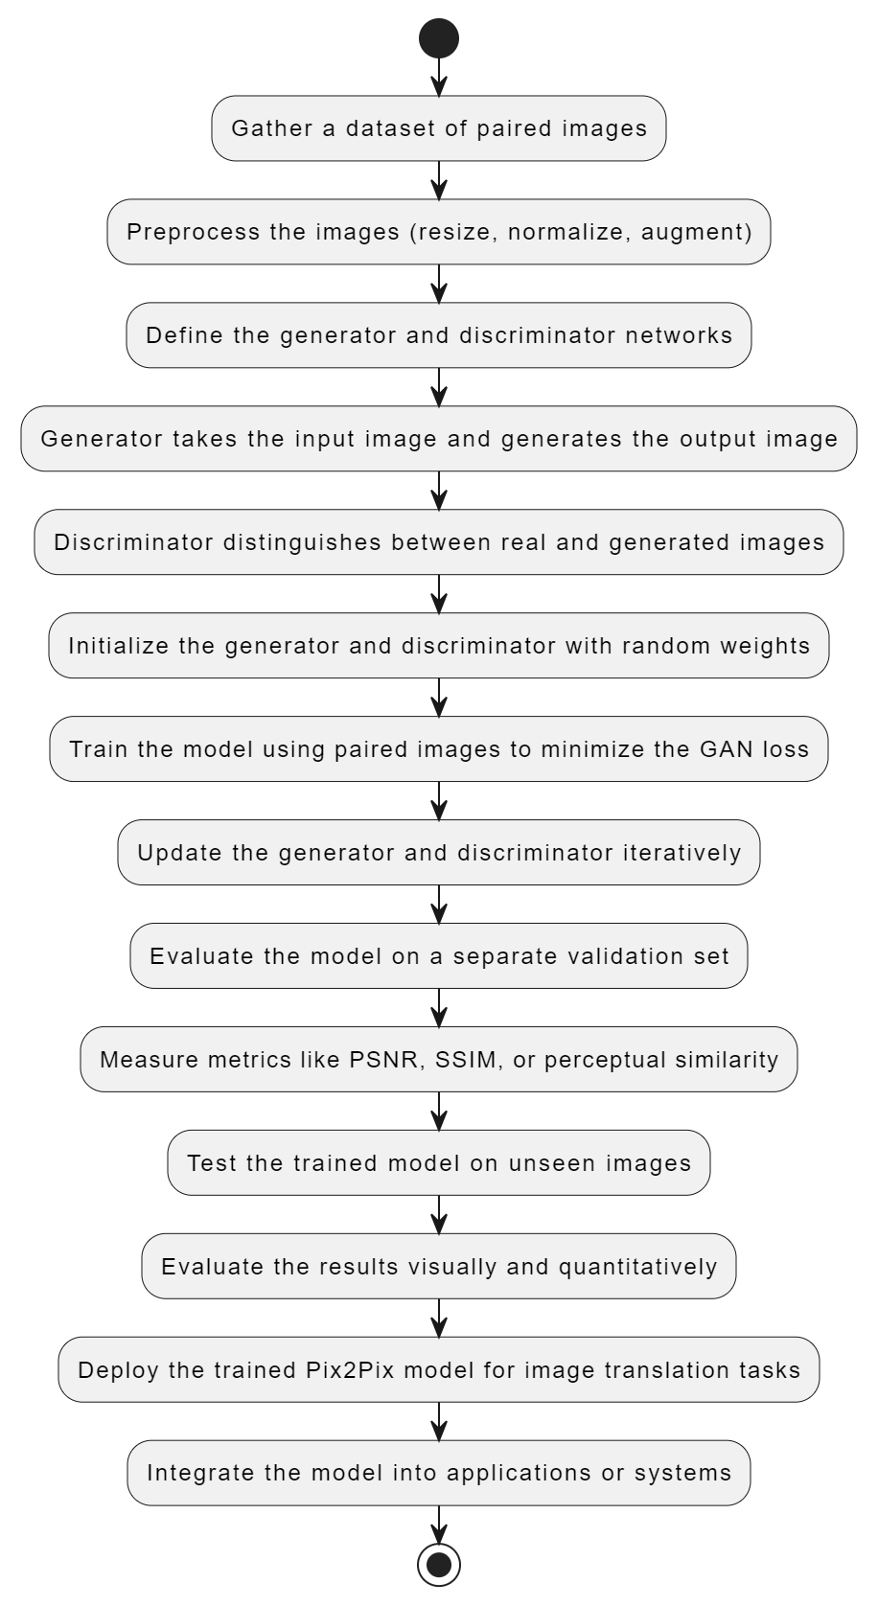
MODELLING
3/21/2024 Annual Review
‹#›

Slide 10
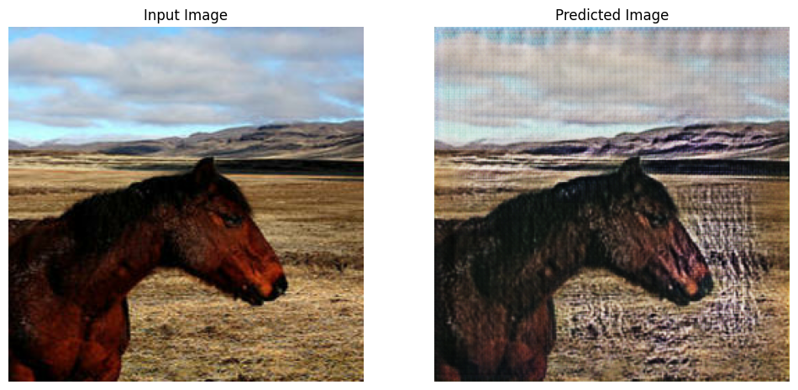
RESULTS
1.test_horses.take(5): This part of the code selects the first five images from the dataset of horse images. The result would be a batch of five input images of horses.
2.generate_images(generator_g, inp): This function generates translated images from the input images of horses. Each input image (inp) is passed through the generator network (generator_g), resulting in translated images. Since five input images are passed, the output would be a batch of five translated images.
HERE IS AN EXAMPLE IMAGE GENERATED BY MY CODE:
https://github.com/Cyril1708/TNSDC-Generative-AI
3/21/2024 Annual Review
‹#›

